Slide 1

Joint Species Distribution Models and Drivers of Biodiversity Change
MLU Block Course
Introduction to Biodiversity Informatics Part II
May 8, 2023
Dr. Kimberly Thompson

Slide 2
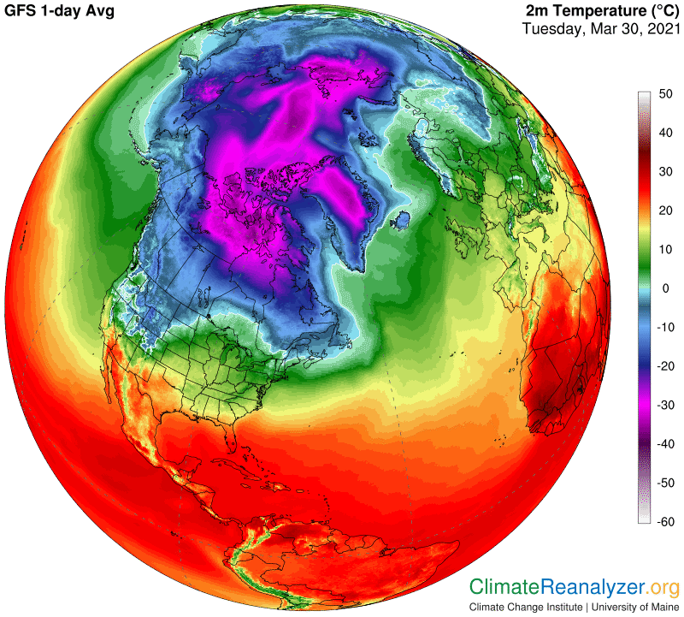
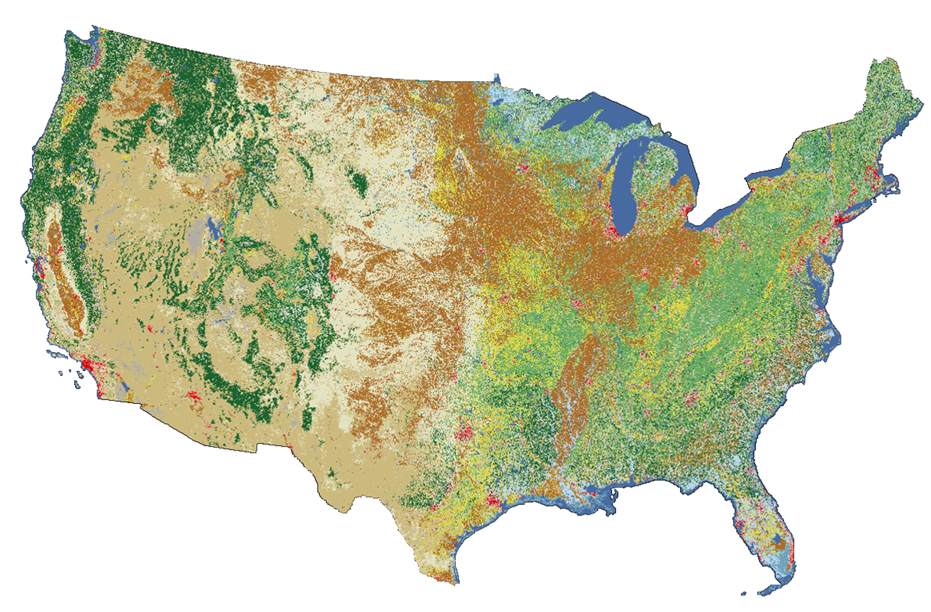


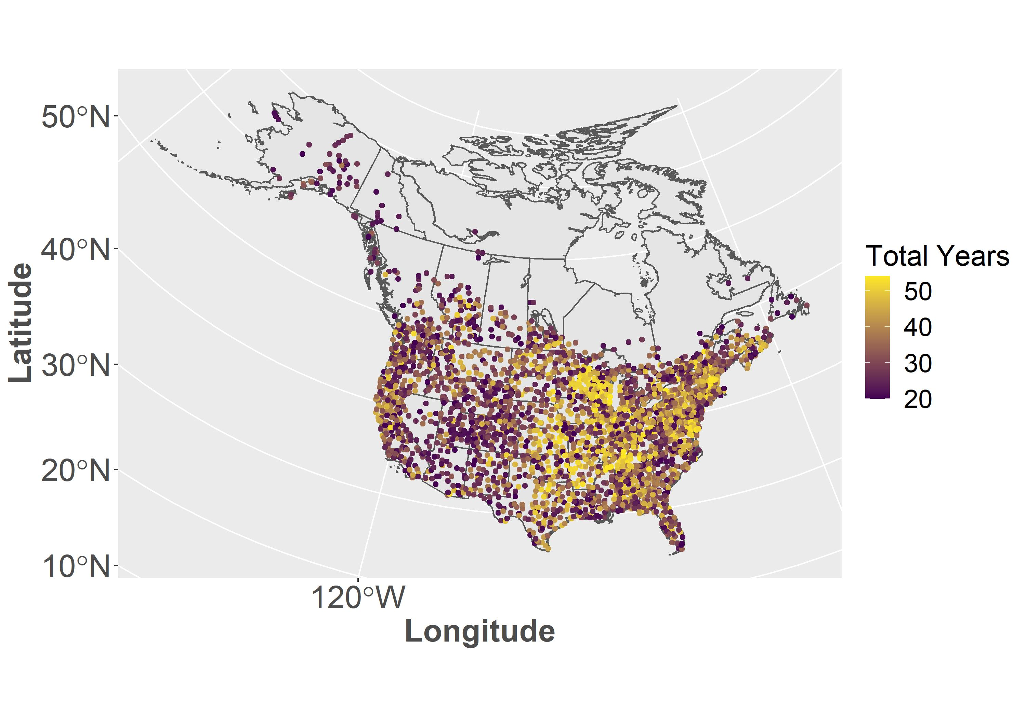

Who Am I?

Slide 3
Who Are You?
Your name
What attracted you to this field of study?
Your favorite part of this class so far
Your least favorite part of this class so far

Slide 4
Ecological Niches
What is a niche?
Grinnell (1917): ‘the sum of habitat requirements and behaviors that allow a species to persist and produce offspring’
Elton (1927): ‘the place of an animal in the abiotic environment, its relation to food and enemies’
Hutchinson (1959): Formalized the niche concept by defining it as an n-dimensional hypervolume
Fundamental vs. Realized Niches according to Hutchinson
Fundamental niche = hypervolume that the species requires to persist
Realized niche = what remains from the hypervolume after interactions with other species are taken into account
Notes:
What is a niche?
Grinnell – ecological requirements
Elton – functional status of the organism
Hutchinson – n dimensions are the environmental and resource characteristics that the species requires to persist
Fundamental vs. Realized

Slide 5
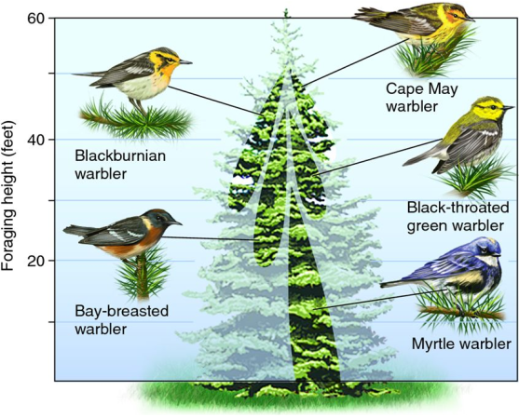
Ecological Niches
Fundamental: entire set of conditions under which an individual can survive and reproduce
Realized: actual set of conditions used by the individual
Notes:
Fundamental vs. Realized
Example of Warblers = niche partitioning

Slide 6
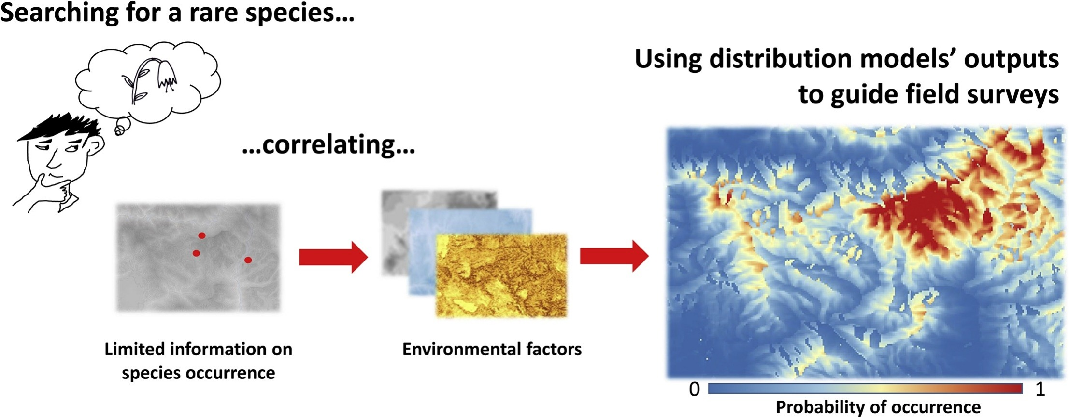
Species Distribution Models
Fois et al. 2018
Notes:
Species distribution models focus on the ecological niche, more specifically, quantifying the niche of a species.
How do they do this? They look for associations between where species or individuals are found and what the environmental characteristics of those places are.
What this means though that SDMs are correlative – species associations with their environment. They are not causative, so we can’t say that a species is present in a place because the temperature is a certain level.
Discussion about whether it’s quantifying the fundamental niche or the realized niche - Fundamental because at core it looks for habitat suitability, realized bc since it’s built with data on actual occurrences or abundances, it likely captures at least part of the realized niche. Draw a distribution with species x environmental characteristic to illustrate that the core part of that distribution represents the species optimal requirement. At the same time we are examining where species actually are in this distribution, so we are looking to understand their realized niche.
Pause for questions about the niche concept and the basic goal of SDMs

Slide 7
Many different types of SDMs
Boosted Regression Trees
Multivariate Adaptive Regression Spline
Generalized Linear Models (GLM)
GAM with spatial structure
MaxEnt
Generalized Additive Models (GAM)
Support Vector Machines
Gradient Nearest Neighbor
GLM with spatial random effect
Gradient Extreme Boosting
Random Forest
Multivariate Regression Tree
Norberg et al. 2019
Notes:
There are many different types of SDMs, and each of these come with their own specific assumptions and analytical framework.
In fact these are only a small subset, and a recent review investigated 33 different types of SDMs to compare their accuracy.
Have you had experience with any of these in your classes?

Slide 8
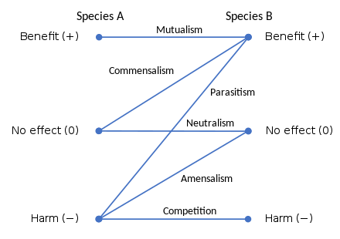
Limitations of traditional SDMs
The realized niche of an individual (and more broadly a species) can be influenced by far more than just its associations with the environment.
Species
Interactions
Notes:
So SDMs associate a species occurrence or abundance in an area with the environmental characteristics of that area. What do you think would be some of the limitations of this approach?
In reality, however, we know that the realized niche of a species can be influenced by far more than just its associations with the environment.
Individuals do not exist in isolation, so where they occur will be influenced by their relationships with other individuals (ex. Relationship of predator to prey).

Slide 9

Limitations of traditional SDMs
The realized niche of an individual (and more broadly a species) can be influenced by far more than just its associations with the environment.
Dispersal
Notes:
An individual may be able to thrive in a particular place, but whether they can actually get there, so their dispersal ability, has an impact on their realized niche.

Slide 10
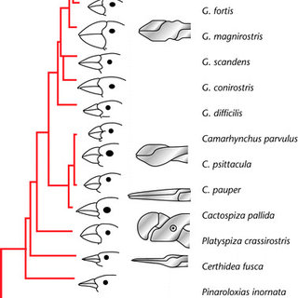
Limitations of traditional SDMs
The realized niche of an individual (and more broadly a species) can be influenced by far more than just its associations with the environment.
Traits
Phylogeny
Notes:
Species have a unique set of traits that influence their responses to the environment. For example beak size and shape will determine the types of seeds birds can eat.
At the same time, these traits have evolved over time and are continuing to evolve, making a species phylogeny important as well.
Additionally, phylogenetically related species can be expected to be similar in terms of both traits and occurrence patterns. So if we only had data for C. parvulus, but we needed to know about the distribution of C. pauper, we could use the distribution of parvulus to make some inferences about pauper.

Slide 11
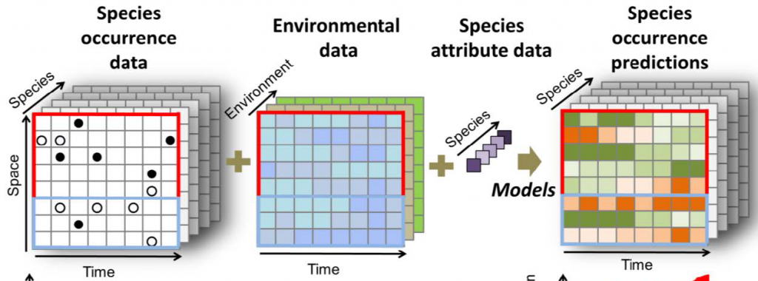
Joint Species Distribution Models (JSDMs)
Dispersal
Traits
Phylogeny
Notes:
This is where Joint Species Distribution Models come in. They extend previous SDMs that only focus on associating a species with their environment and also include the species attributes that we just discussed.

Slide 12

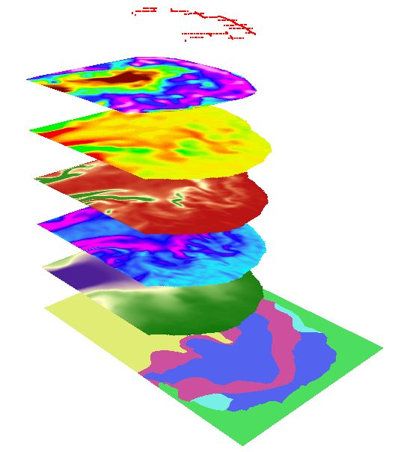
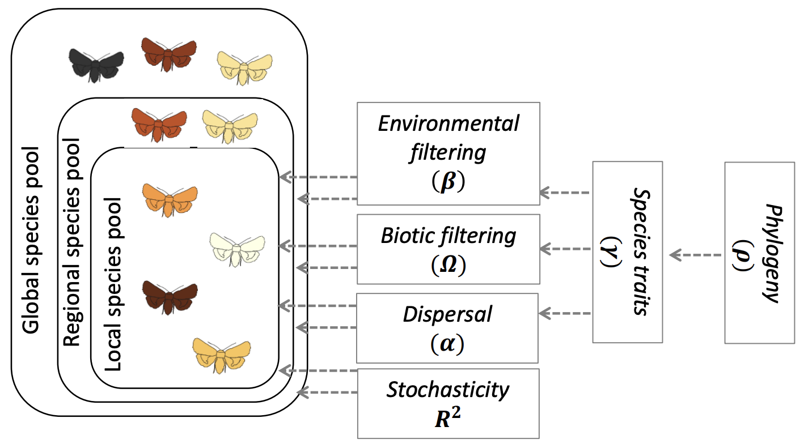
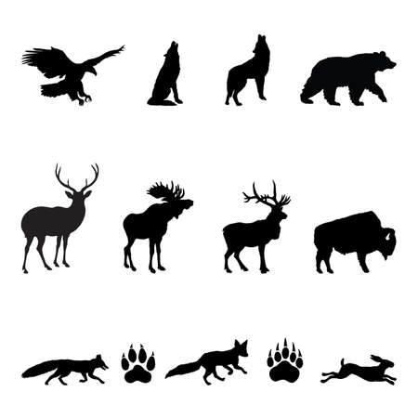
Stacked SDMs vs. JSDMs
Stacked SDMs vs. Joint SDMs
Notes:
To understand the benefits of JSDMs it is helpful to compare them to another method that was proposed as a way to overcome some of the limitations we discussed – stacked SDMs.
Stacked SDMs are essentially single species SDMS that are combined after the modeling process. That means that they assume species-specific responses to the environment, so each species reacts in its own particular way to the environment, because each species is modeled separately. So each SDMs is fit separately for each species and then we would overlay the results to see where species could co-occur.
On the other hand, JSDMs model all species together, so they assume that there could be shared responses to the environment. JSDMs combine the species–specific models in one hierarchical layer that models shared responses to the environment. By modeling all the species simultaneously it also is able to take into account information on co-occurrences or the lack of co-occurrences, which is not something that is possible in stacked SDMs.
So we’ve got environmental filtering – that’s the effect of the environment on the species, biotic filtering – that’s our species interactions, dispersal, stochasticity which is just random variation that could occur, traits, and phylogeny.

Slide 13
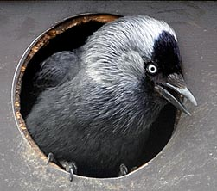

Hierarchical Modelling of Species Communities
Hmsc package in R
Simulated Data
Linear model
Presence absence model
Abundance model
Real World Example with Finnish birds
Corvus monedula, Western Jackdaw
Notes:
The type of JSDM we are going to use today is called Hierarchical Modelling of Species.
Today though we are going to just use environmental data to make predictions. So our approach will more like a traditional SDM, but the idea is just to introduce you to the process of creating a JSDM and to help you understand conceptually what they can do and practically how they are built.
We will first explore JSDMs with simulated data and build three different models, a basic linear model, a presence absence model, and an abundance model.
Then we’ll look at a real world example and examine the distribution of Corvus monedula, the Western jackdaw.

Slide 14
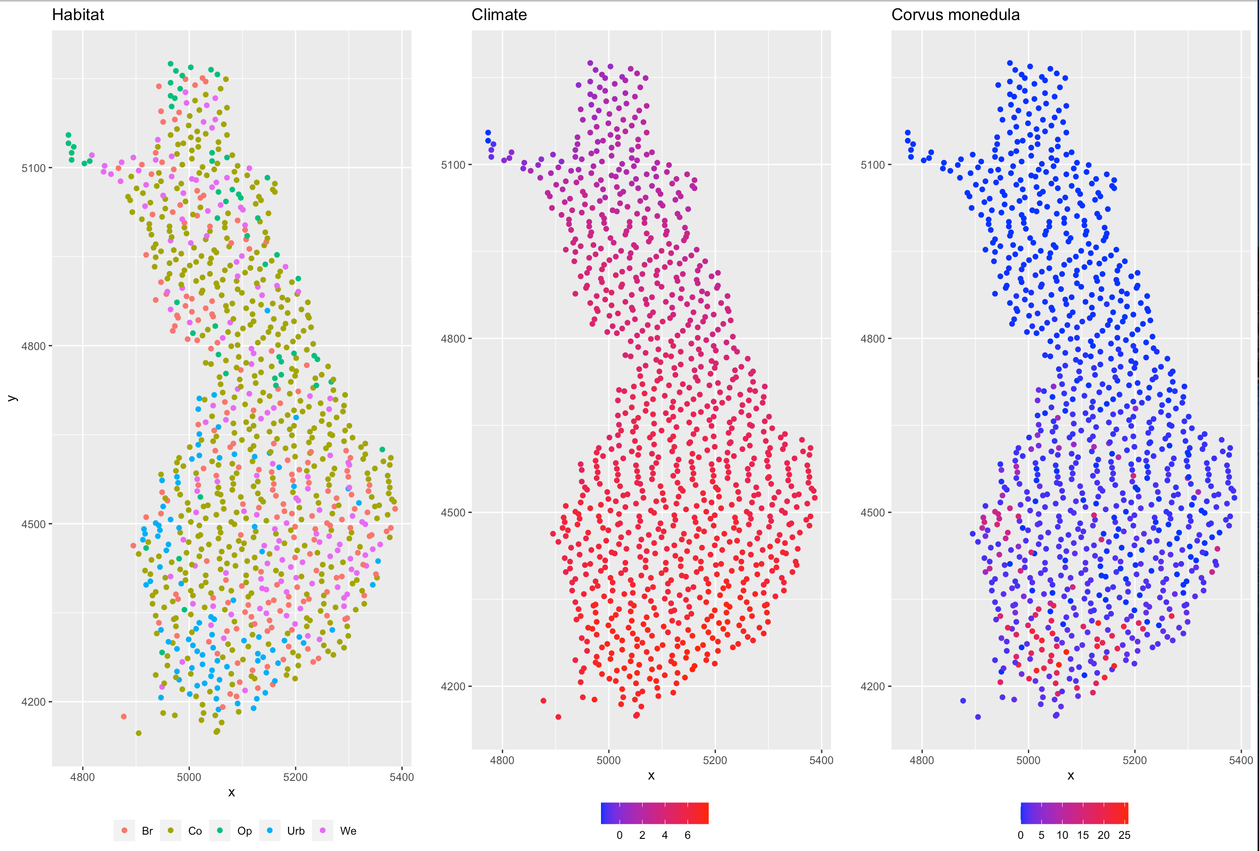

Slide 15
Joint Species Distribution Models (JSDMs)
Full functionality of JSDMs:
Multiple species
Environmental, trait, and phylogenetic predictors
Handle hierarchical and spatially structured data
Explicitly account for stochasticity through variance partitioning
Our introduction:
Single species
Environmental predictors only
Examples with hierarchical and spatially structured data
Notes:
What proportion of the variance is unexplained and therefore attributable to stochastic processes?
unexplained residual spatial or temporal autocorrelation

Slide 16
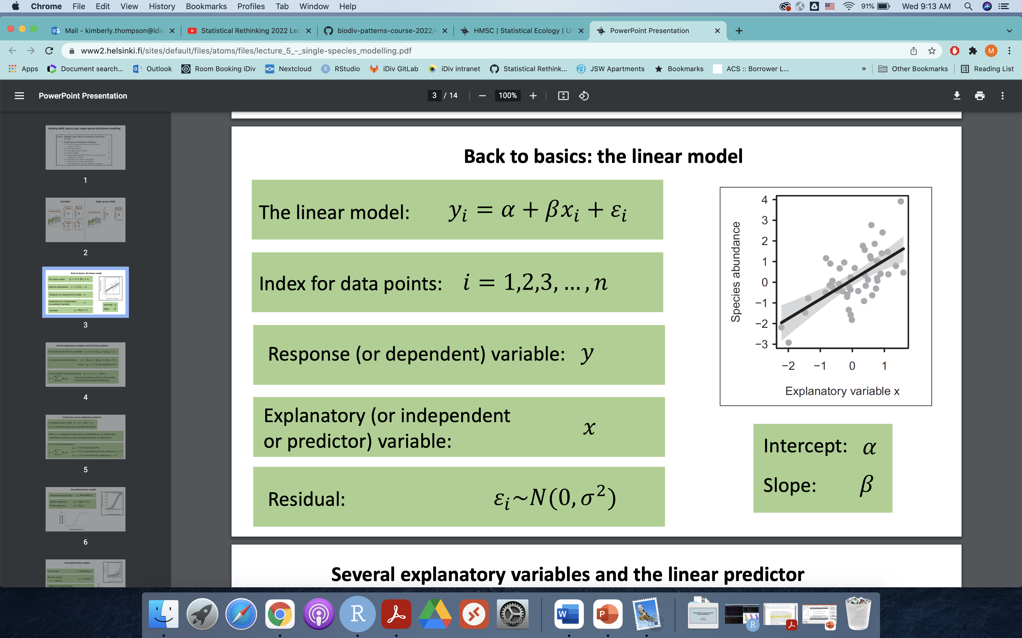
Notes:
Reminder of form of the linear model
Y is typically the occurrence or abundance of a species and x is what we hypothesize will help explain y, in this case usually an environmental variable (like climate condition)
Let’s think about what each of these terms actually tells us about a species distribution – if beta is positive, then the response variable increases with the explanatory variable, if beta is negative, the response decreases as the explanatory increases, if beta =0, the response variable doesn’t depend on the explanatory variable.
The intercept tells us what the expected value of the response variable will be when the explanatory variable equals 0.

Slide 17
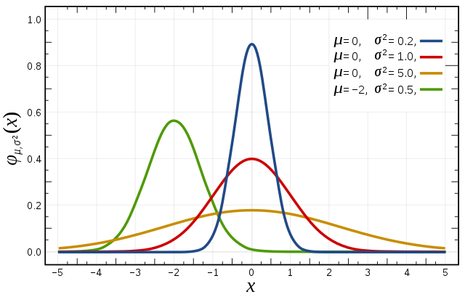
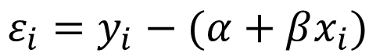
Back to basics: the linear model
$$ε_{i}=y_{i}−(α+βx_{i})$$
Notes:
Error I is the residual related to sampling unit I or rather the observed yi and the predicted (alpha plus beta*xi). We can confirm this by simply rearranging our equation:
In a linear model the residuals are assumed to be normally distributed with a mean of 0 and a variance of sigma2.

Slide 18
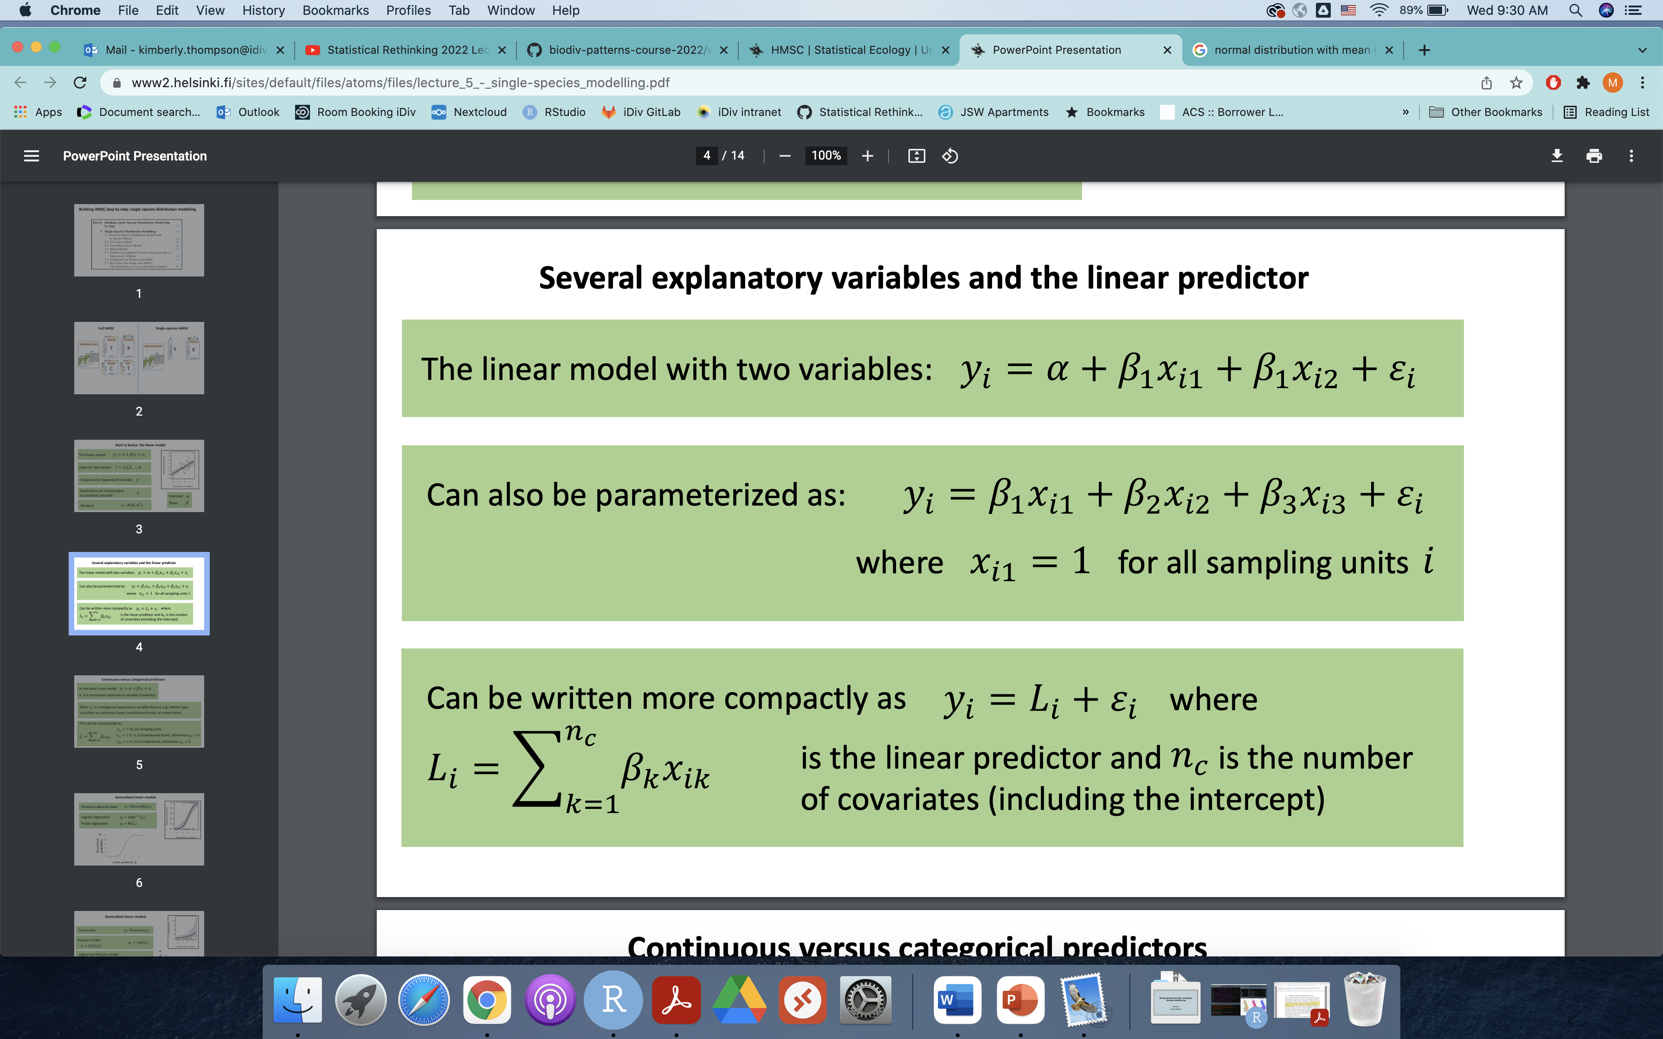
2
Notes:
When we increase the number of predictors we can abbreviate
You will see in the code that we define the model as L + error term

Slide 19
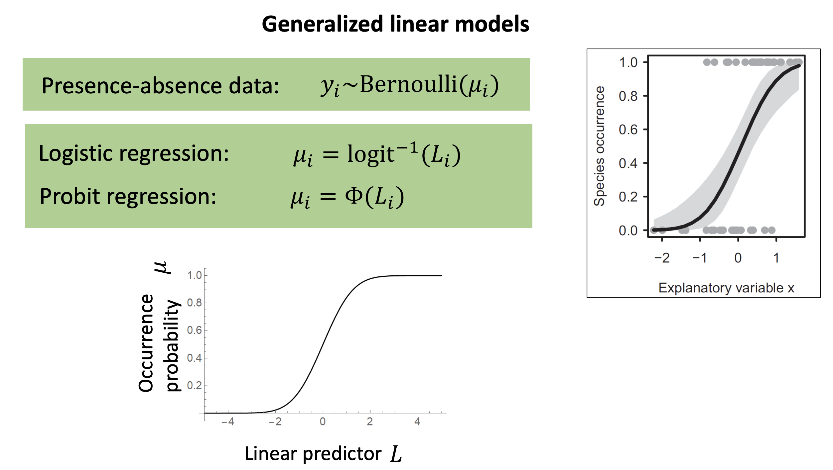
Notes:
Survey data on species occurrences (i.e. presence/absence) are usually not normally distributed. This makes intuitive sense since such data are composed of 0’s and 1’s.
A natural distribution for binary variables is given by the Bernoulli distribution. Here μi is the expected value, which in the case of the Bernoulli distribution equals the probability
of the response variable being one. So the probability that yi = 1 μi and consequently yi = 0 with a probability of 1 μi – so a simple binary outcome.
A problem arises though because if we set μi = Li, we won’t have a good model because the linear predictor can be any real number, but we need mu to be a probability, so a number between 0 and 1. So we use a non-linear link function to make sure our μi values fall between 0 and 1.
The link function simply limits the values our response can take. Many of you might be familiar with the logit link function which is typically used in logistic regressions so that the predicted y values are between 0 and 1.
For our purposes today, since we will be working with the Hmsc package in R, the Hmsc package uses instead the probit link function.
The probit link is used not for a philosophical or ecological reason, but simply because when we scale up in model many species, a probit model is easier to fit than a logistic one. In any case you can think of the probit model as one that (similar to logistic regression) uses a link function that limits model predictions to be 0 <= y <=1.

Slide 20
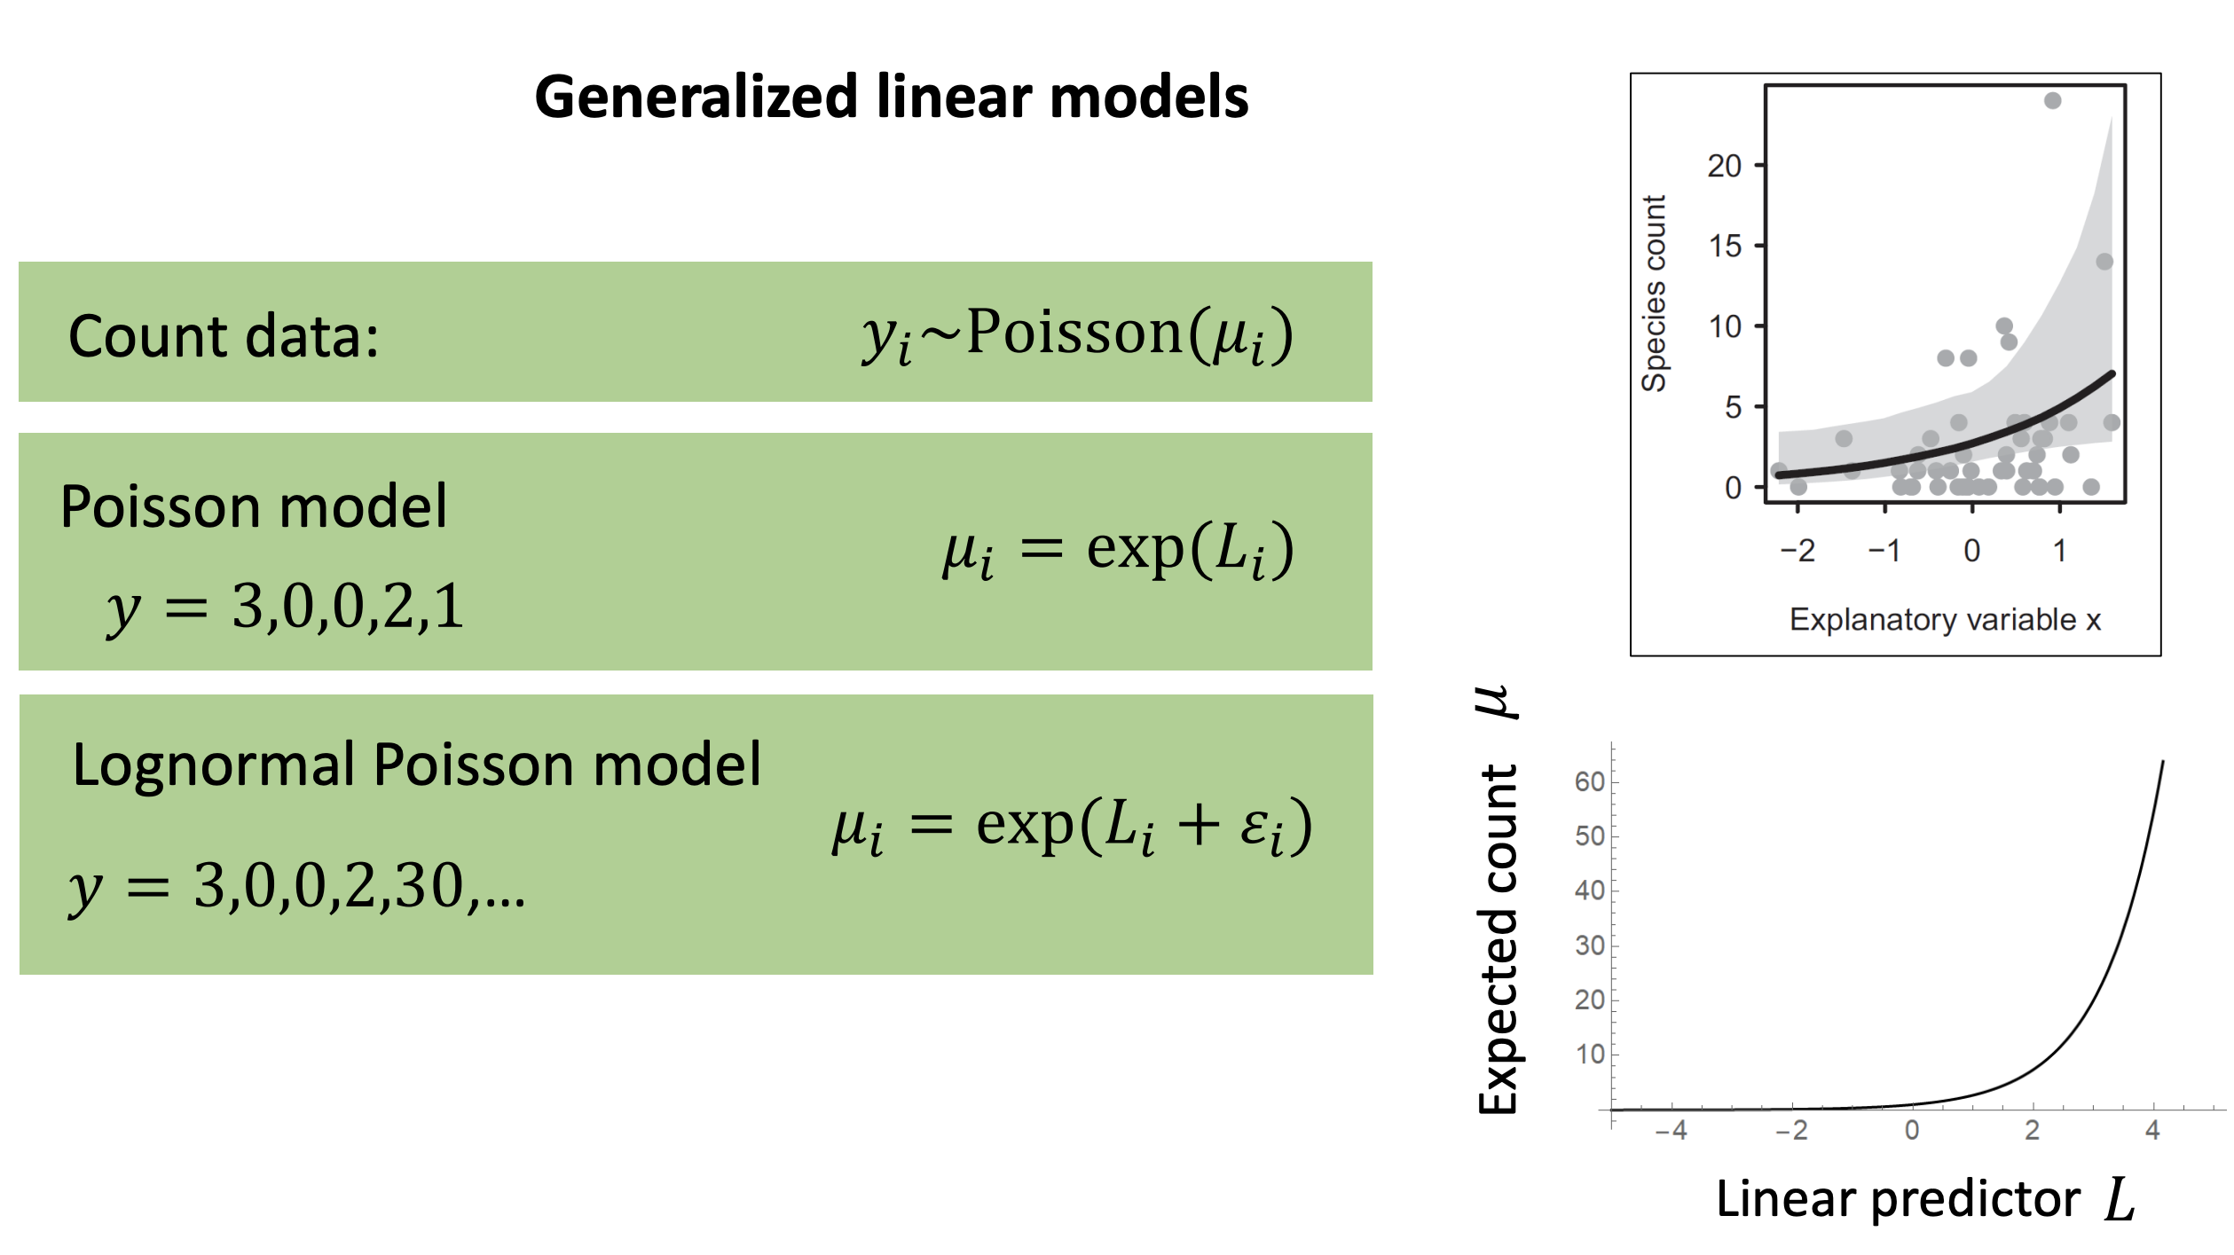
Notes:
Count data, or abundance data are also not normally distributed, so we can’t use the linear model in this case either.
So in this case our response can be any non-negative integer. To restrict our response to these types of values only, we need again a suitable link function and error distribution.
In addition to limiting our responses to non-negative integers, we also need a link function and error distribution that allow for substantial variation – because typically from count data, we may have 0 values followed by much higher values.
Hmsc uses the lognormal Poisson model, again because while there are other options, this model is easier to implement for multivariate hierarchical models.
(lognormal poisson as opposed to regular poisson allows sigma/variance to be estimated which is critical for abundance data, regular poisson does not – in regular poisson the variance can’t be estimated separate from the mean – so they’re taken to be equal which wouldn’t work for ecological abundance data)
If they have more questions
The lognormal Poisson model is given by:
yi ~ Poisson(exp(Li + εi)), εi ~N(0, σ2) (5.6)
Thus, the lognormal Poisson model differs from the baseline Poisson
model by adding normally distributed noise to the linear predictor. Now,
increased variance σ2 in the normal distribution leads to increased variation
in the outcomes yi.
The exponential function ensures that the mean of the Poisson distribution μi= exp(Li)
is positive.

Slide 21
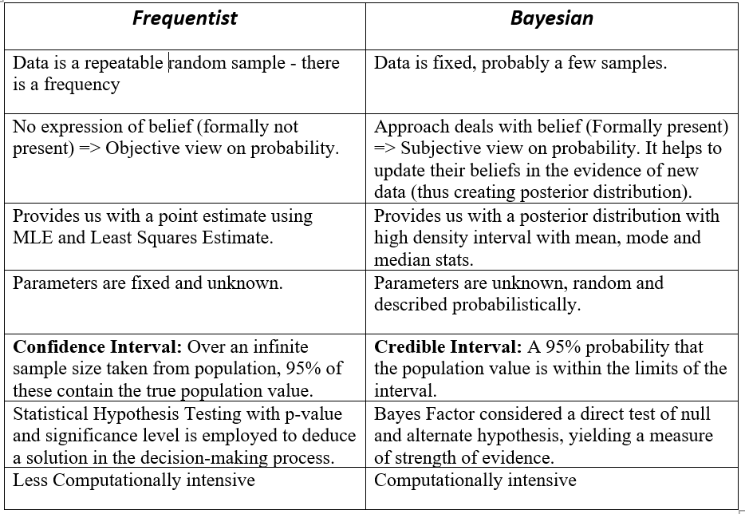
Notes:
Another key characteristic of Hmsc is that it uses Bayesian inference, again entire courses and textbooks are dedicated Bayesian analysis, but for our purposes today we just want to be aware of the basic ideas and concepts that are part of the Bayesian framework.
Typically when we start out in statistics we learn frequentist statistics first, so I find that it is easier to grasp the concepts by contrasting the Bayesian framework to the frequentist framework.
Flip a coin – and now analyze as if we flipped coin infinite number of times
Bayesian acknowledges that we likely have prior belief or knowledge which could be used.
-
-
-
Should I reject my hypothesis? Vs. Given my hypothesis is true, how likely is the data?

Slide 22
Let’s get started!

